Slide 1
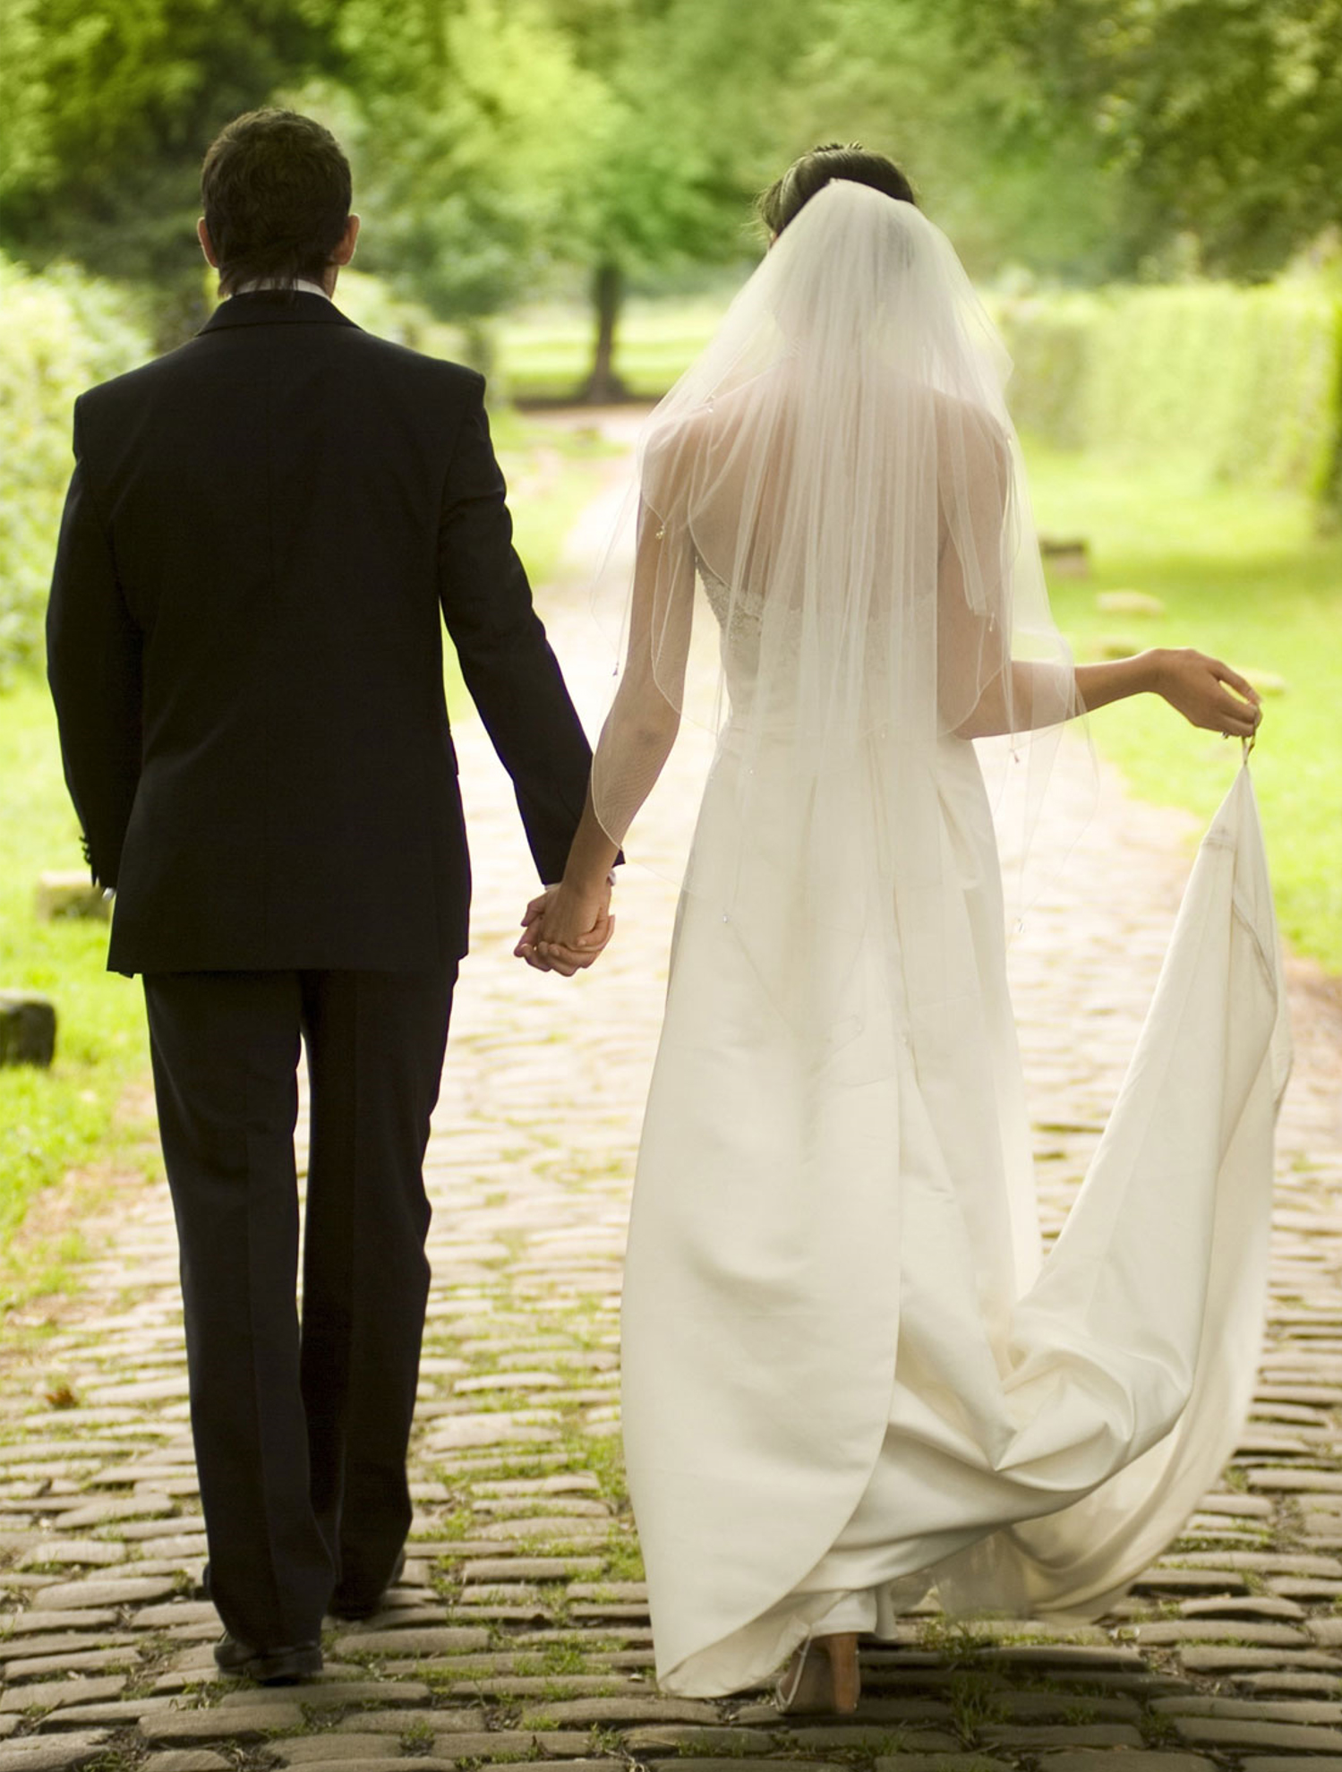
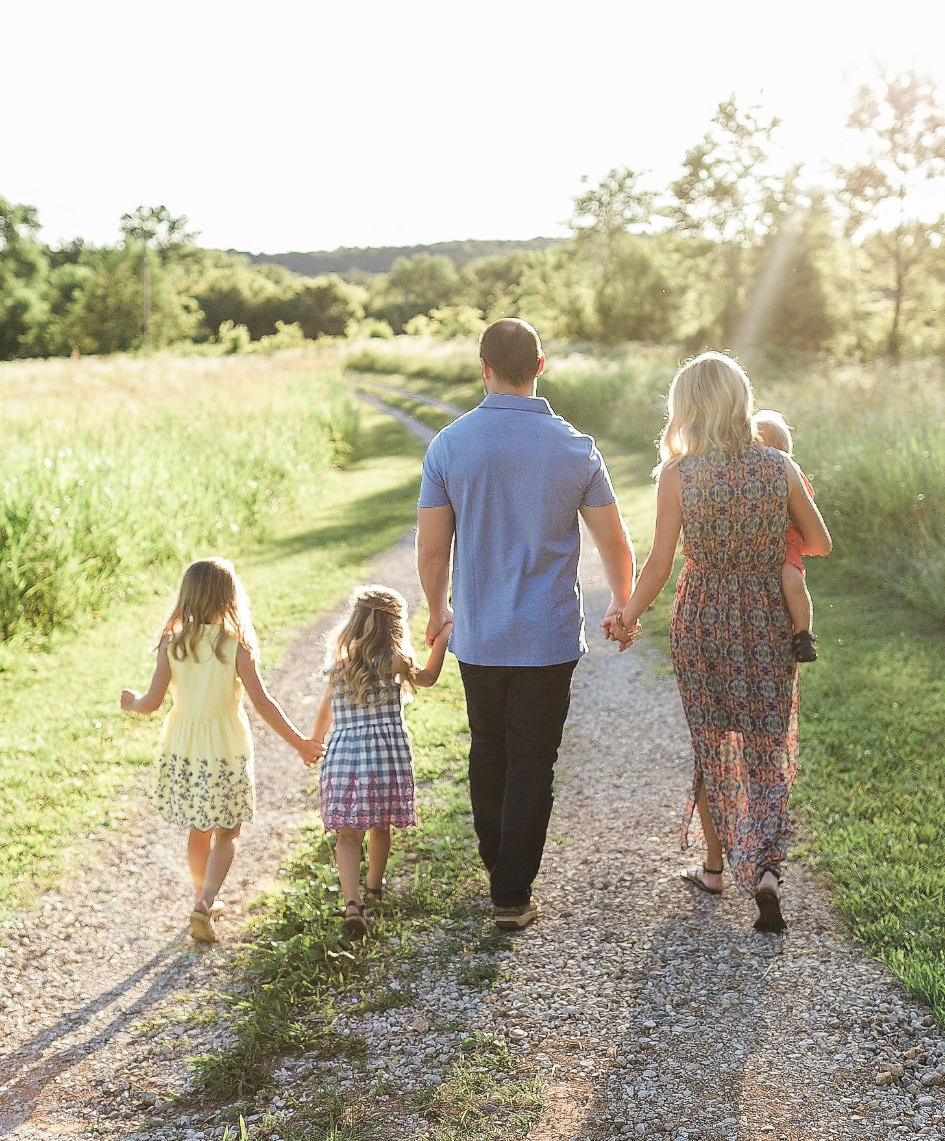
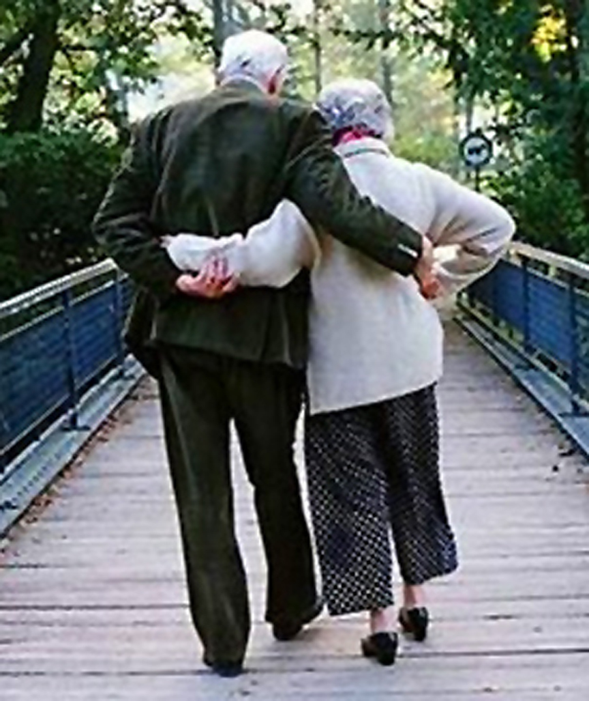
Married:
Growing & Serving Together
Romantic Love in Marriage
A Study of Marriage, Spring 2023

Slide 2
The Love Languages
Review
Words of Affirmation
Quality Time
Receiving Gifts
Acts of Service
Physical Touch

Slide 3
The Love Languages
Concluding Thoughts
Review
These ideas build on the scriptural principle of “living together with understanding.” (1 Peter 3:7)
Identifying the “love language” of our spouse opens the possibility to a much deeper and satisfying relationship which more fully reflects the design for marriage that God intended from the beginning.

Slide 4
So, What Do We Mean By Romantic Love in Marriage?

Slide 5
Dictionary Definitions:
Romantic, adjective, ro·​man·​tic /rō-ˈman-tik/
Consisting of or resembling a romance – Merriam-Webster
Relating to love or a close loving relationship; exciting and mysterious and having a strong effect on your emotions – Cambridge Dictionary
Someone who is romantic or does romantic things says and does things that make their wife, husband, girlfriend, or boyfriend feel special and loved.- Collins Dictionary
Expressive of, or exciting, sexual love or romance – Vocabulary.com
Romance or romantic love is a feeling of love for, or a strong attraction towards another person, and the courtship behaviors undertaken by an individual to express those overall feelings and resultant emotions. – Wikipedia

Slide 6
So, What Do We Mean By Romantic Love in Marriage?
Class Input:
Things that create & sustain the foundation for romance:
Regular attention
Gratitude
Respect
Adoration
Passion
Commitment
Making oneself available to be a listener, comforter, advisor, and confidant day in and day out.
Communicate clearly and often.
Be truly grateful for your spouse and tell them regularly.
Learn your spouse’s likes and dislikes and joyfully cater to them.
Mutually agree upon ways to lovingly disagree and follow those rules.
Build trust and then work hard to keep it.
Forgive one another quickly and fully and verbalize it.
Then, any romantic efforts/gestures will be well received.

Slide 7
Four Primary Ancient Greek Words for Love
Which Refers to Romantic Married Love?
Notes:
We use the English “love” in many ways. Actually 7 Grk words (including self love, pragmatic love, and flirtatious love).
Agape is a decision-based love. Something we decide to do because it is good and right; it is unconditional.
Philia is experience based – Friendship based on Constancy, Transparency & Candor, and Common Interests and Aspirations
Storge is why we say “blood is thicker than water;” it’s why we can fight w/ siblings but still love them intensely. Unconditional
A form of Eros used in the Grk translation for the “lovers” of the idolatrous Israelites by Hosea, Jeremiah, & Ezekiel

Slide 8
Four Primary Ancient Greek Words for Love
Reason
“I Commit to you”
“There seems to be another kind of love, at least another type of which we speak in English. There is [was] no separate Greek word for what we call romantic love. Logically, it is a mix of philia and the intense desire of eros. During courtship and early marriage, it is usually very strong...It would be a mistake to base a lifelong relationship on a romantic, shallow, temporary “love” – not the living, growing, action-based “love” of agape...Typically, throughout a marriage, a woman will place more value on the emotional aspect of romantic love than a man. Husband-to-be and husband-of-many-years, please listen up! This is important. Learn to cultivate romantic love throughput your marriage no matter how many years you are together. Don’t forget the things you did to win her love; they may be the same kind of things that will nurture your love throughout the years.” – Charlie Brackett, Get Ready, Get Set, I Do, 2006
Affection
“I like you”
Family
“You are family”
Passion - “I want you”
I Believe,
All of Them!
Which Refers to Romantic Married Love?
Notes:
Not just philia + eros

Slide 9
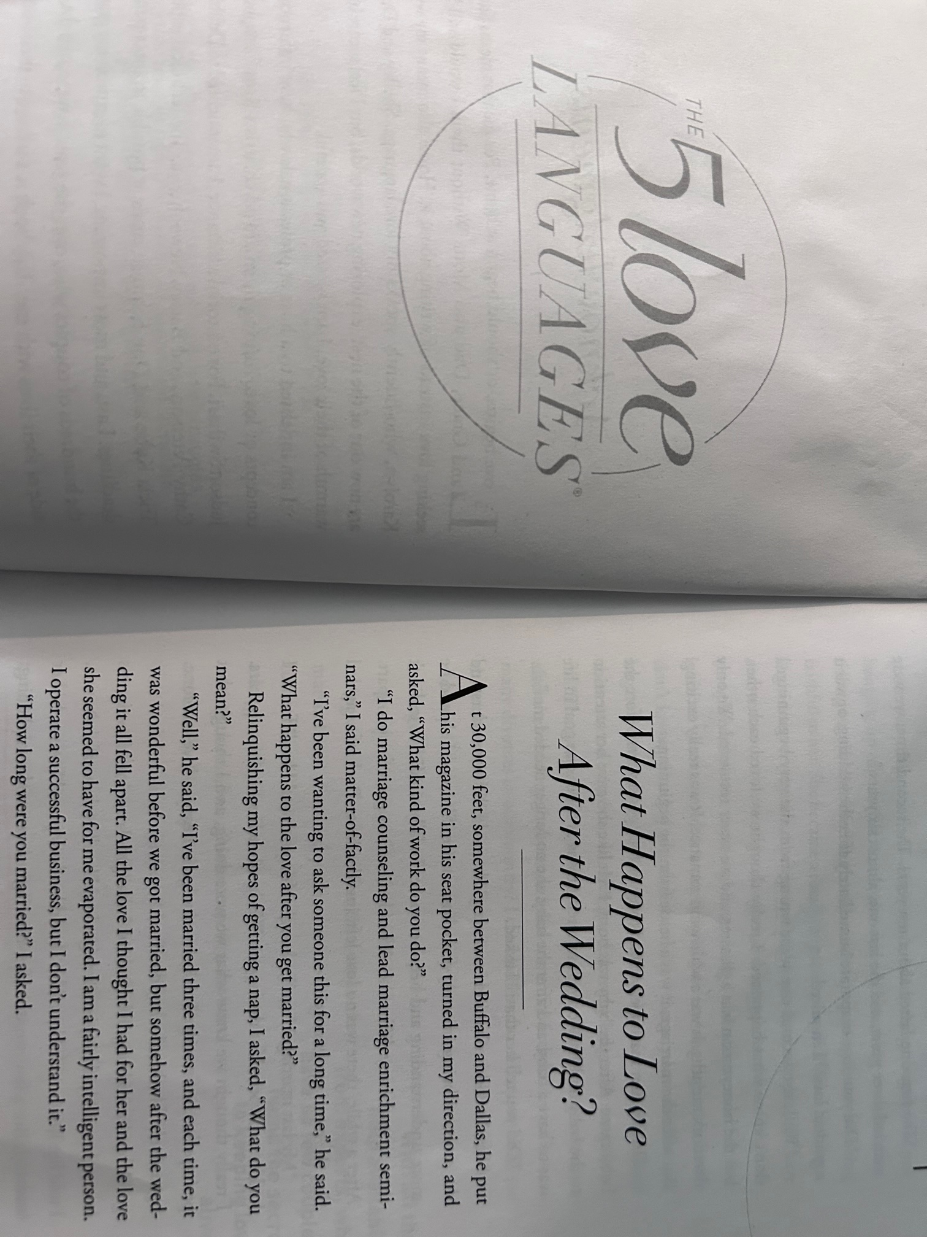

“In Love” / “Falling in Love” vs. Married Romantic Love
“People get from books the idea that if you have married the right person you may expect to go on “being in love” for ever. As a result, when they find they are not, they think this proves they have made a mistake and are entitled to a change—not realizing that, when they have changed, the glamour will presently go out of the new love just as it went out of the old one.” – C. S. Lewis, Mere Christianity
Chapter 1
Falling “in love” AND
“out of love” are
Common Expressions
“Well,” he said, “I’ve been married three times, and each time, it was wonderful before we got married, but somehow, after the wedding it all fell apart.”

Slide 10
“In Love” / “Falling in Love” vs. Married Romantic Love
“When you first fall in love, you think you love the person, but you don’t really. You can’t know who the person is right away. That takes years. You actually love your idea of the person—and that is always, at first, one-dimensional and somewhat mistaken. In The Lord of the Rings, Eowyn falls in love with Aragorn, but he cannot return the love...Aragorn understood that romantic flings are so intoxicating largely because the person is actually in love with a fantasy rather than a real human being.
But not only do you not know the other person, but the other person does not really know you. You have put on your best face (often quite literally.) There are things about yourself that you are ashamed of or afraid of, but you don’t let the other person see your flaws. And, of course, you cannot show your partner those parts of your character that you cannot see yourself and which will only be revealed to you in the course of the marriage.” – Tim and Kathy Keller, The Meaning of Marriage, 2011
“Love is the irresistible desire to be irresistibly desired.” – Mark Twain
Notes:
Ay-uh-win

Slide 11
“In Love” / “Falling in Love” vs. Married Romantic Love
“There is an emotional “high” that comes to us when someone thinks we are so wonderful and beautiful, and that is part of what fuels the early passion and electricity of falling in love. But the problem is—and you may be semiconsciously aware of this—the person doesn’t really know you and therefore doesn’t really love you, not yet at least. What you think of as being head over heels in love is in large part a gust of ego gratification, but it’s nothing like the profound satisfaction of being known and loved...

Slide 12
Marry Your Best Friend
“He is my lover and friend”
(Song of Solomon 5:16, CEV)
  Transparency and Candor – Friends are totally open and feel free to both affirm & critique each other.
  “Oil and perfume make the heart glad, and the sweetness of a friend comes from his earnest counsel.” (Prov. 27:9)
  “Better is open rebuke than hidden love. Faithful are the wounds of a friend” (Prov. 27:5-6)
  “As iron sharpens iron, so a person sharpens his friend” (Prov. 27:17)
  “Therefore, confess your sins to one another and pray for one another, that you may be healed” (Jas. 5:16)
  “And let us consider how to stir up one another to love and good works” (Heb. 10:24)
  “To love and to cherish, till death us do part”
“When over the years someone has seen you at your worst, and knows you with all your strengths and flaws, yet commits him- or herself to you wholly, it is a consummate experience. To be loved but not known is comforting but superficial. To be known and not loved is our greatest fear. But to be fully known and truly loved is, well, a lot like being loved by God.” - Tim & Kathy Keller, The Meaning of Marriage
Notes:
Slide from our class on April 23rd

Slide 13
“In Love” / “Falling in Love” vs. Married Romantic Love
“There is an emotional “high” that comes to us when someone thinks we are so wonderful and beautiful, and that is part of what fuels the early passion and electricity of falling in love. But the problem is—and you may be semiconsciously aware of this—the person doesn’t really know you and therefore doesn’t really love you, not yet at least. What you think of as being head over heels in love is in large part a gust of ego gratification, but it’s nothing like the profound satisfaction of being known and loved... The kind of love life I am talking about is not devoid of passion, but it’s not the same kind of passion that is there during the days of naïveté. When Kathy first held my hand, it was an almost electrical thrill. Thirty-seven years later, you don’t get the same buzz out of holding your wife’s hand that you did the first time. But as I look back on that initial sensation, I realize that it came not so much from the magnitude of my love for her but from the flattery of her choice of me. In the beginning it goes to your head, and there is some love in that, but there are a lot of other things, too. There is no comparison between that and what it means to hold Kathy’s hand now, after all we’ve been through.”– Tim and Kathy Keller, The Meaning of Marriage, 2011

Slide 14
“Aesthetic Love” vs. Married Romantic Love
Danish philosopher, Soren Kierkegaard described a person with an overriding aesthetic outlook on life as an “aesthete.”
An aesthete often claims to be a free individual. Life should be thrilling, full of “beauty and sparkle,” he says.
But Kierkegaard says that this is a very mistaken idea of what freedom is. Such a person is being completely controlled by external circumstances.
Only if you commit yourself to loving in action, day in and day out, even when feelings and circumstances are in flux, can you truly be a free individual and not a pawn of outside forces. Also, only if you maintain your love for someone when it is not thrilling can you be said to be actually loving a person. The aesthete does not really love the person; he or she loves the feelings, thrills, ego rush, and experiences that the other person brings.
He “argues that marriage actually enhances romantic love, instead of curtailing it. He argues that the ethical commitment to another person in marriage is precisely what enables the spontaneity of romantic love to achieve the stability and longevity that it is unable to provide by itself.”
- Diogenes Allen, Love: Christian Romance
Married romantic love grows out of a decision to love. This ongoing commitment will lead to deeper romantic emotions, not the other way around.
“Any mature, spiritually sensitive view of marriage must be built on the foundation of mature love rather than romanticism. But this immediately casts us into a countercultural pursuit.” – Gary Thomas, Sacred Marriage
Notes:
“S-theet”

Slide 15
So, What Do We Mean By Romantic Love in Marriage?
Do popular movies, shows, & songs portray romance realistically?
Can we expect the giddy “in love” feeling of courtship to continue throughout a marriage?
People in our modern culture see romantic love as all-important but not sustainable. Are they right to say it is unreasonable to expect them to commit to lifelong monogamy in a marriage?
Can a lifelong marriage be built solely on romantic love?
Is it romantic to your spouse when you speak their love language?
If we love and “act loving” toward our spouse, even when we don’t “feel it” in the moment, does that make our love not authentic and kill the romance?
How do we define romantic love in marriage and how important is it? One possible definition:
Romantic love in a marriage is the passionate, all-consuming affection each spouse feels as a result of years of commitment and a decision to unconditionally love each other in every way, every day.

